Slide 1

Hotel Recommendations Based on User Searches
Megan Holford

Slide 2
Business Problem
As technology has become increasingly prevalent in daily life, we have seen the rise in its use among many facets of life. One such area that has seen a great rise in use is within the travel industry.
Artificial intelligence and machine learning has become a major player in the business world and when it comes to the hospitality industry, this is one way that can help increase user satisfaction and the amount of successful bookings. Providing users with tailored suggestion is one way to not only provide a personalized experience, but help users feel that they do not need to look further.

Slide 3
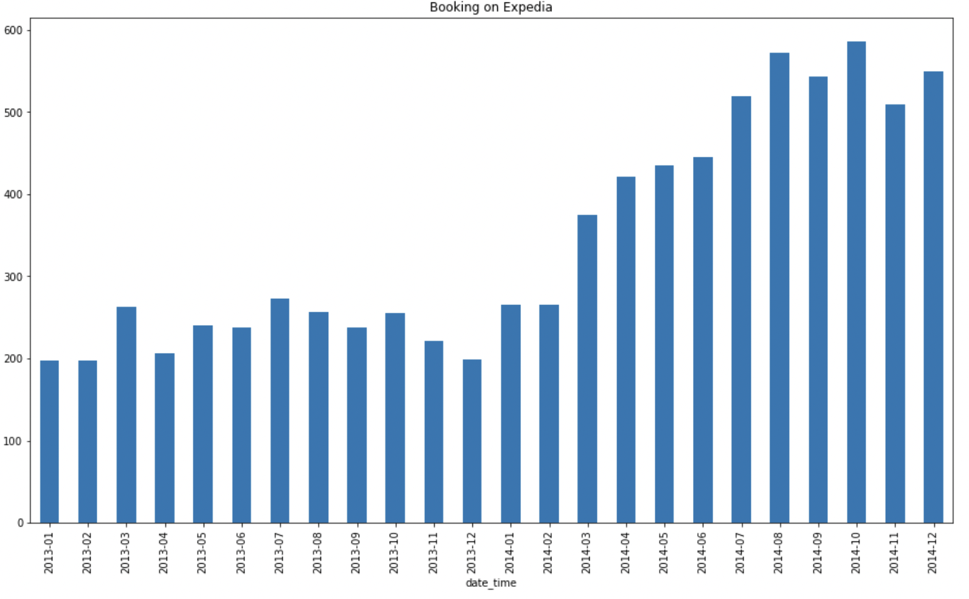
Exploratory Data Analysis
Bookings on Expedia have increased in recent years

Slide 4
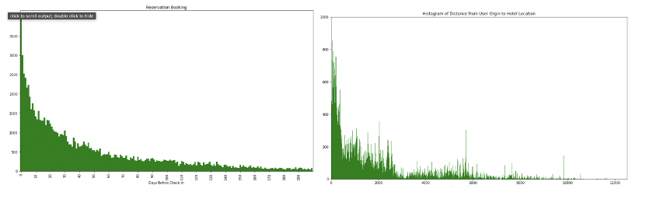
These charts help to understand user booking behavior.

Slide 5
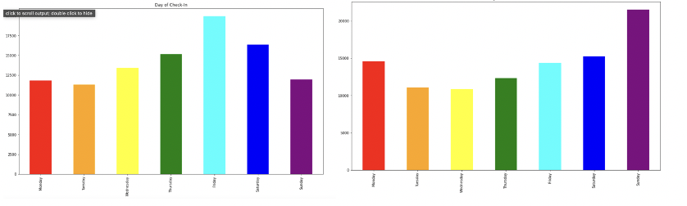
Graphs of most common days to check in and check out

Slide 6
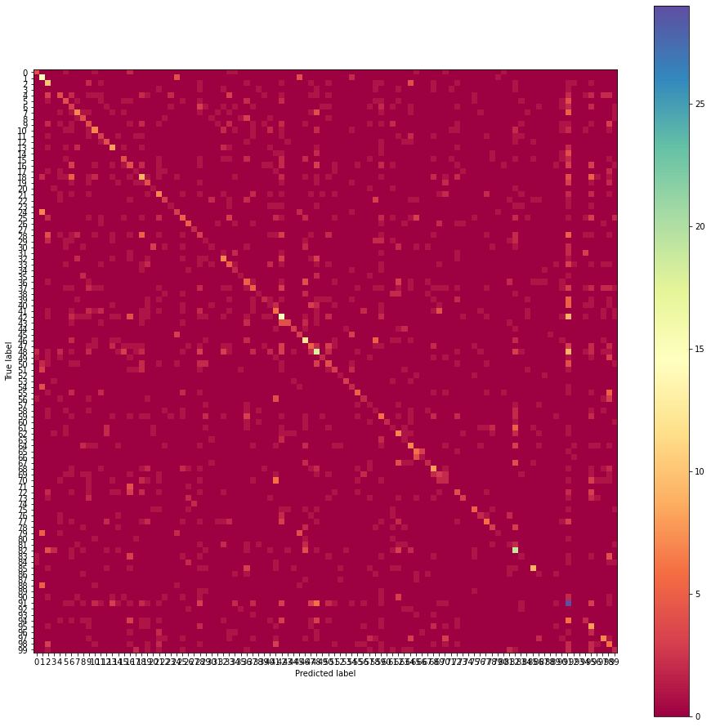
Random Forrest Correlation Map

Slide 7
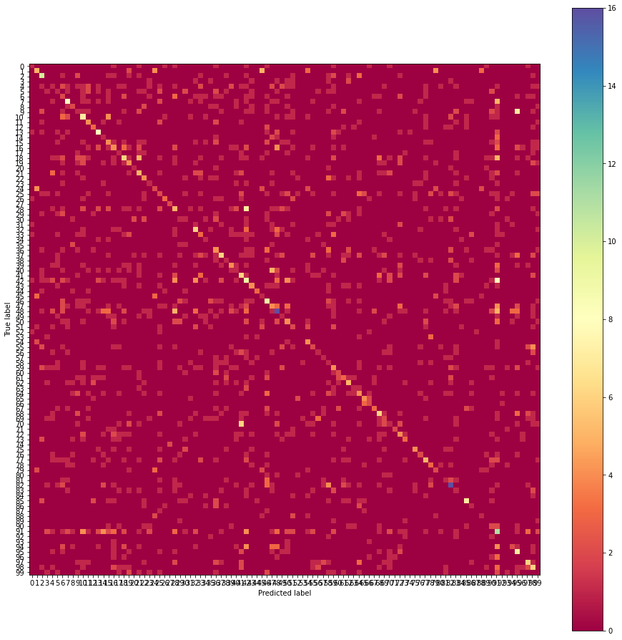
Decision Tree Correlation Map

Slide 8
Conclusions
While we do have algorithms that we used for the project, it is to be noted that none performed particularly well.
Because these models are not testing with high accuracy, it would not be ethical to implement them as is.

